Slide 1
Chap 3 Geometric Representations (3) (几何表示)
Li Guiqing
South China University of Technology

Slide 2

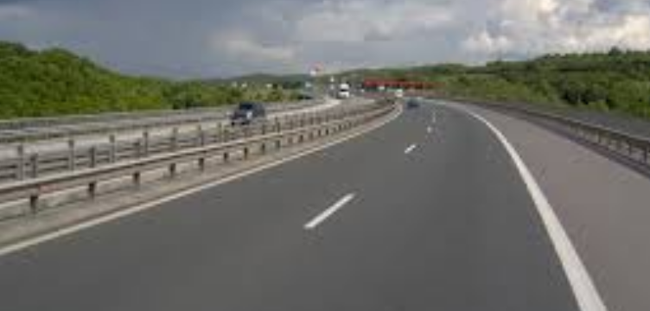
Agenda
Parametric curves and surfaces
(参数曲线曲面）
Simple parametric curves and surfaces
Parametric curves in CAGD
Parametric surfaces in CAGD

Slide 3
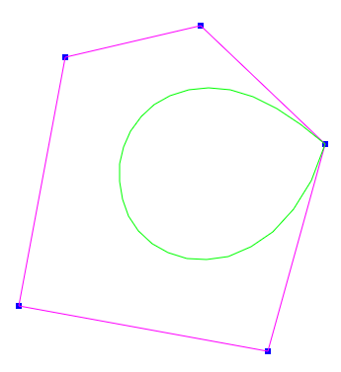
Agenda
Parametric representation of curves and surfaces
What are parametric representations
Bezier curves and surfaces
B-spline curves and surfaces

Slide 4
What are parametric curves: Line segment (直线段)
Line segment: P₀(x₀, y₀, z₀)→P₁(x₁, y₁, z₁)
Parametric representation (参数表示)
Coordinate components (分量表示)
Parametric domain(参数域)[0,1]：

Slide 5
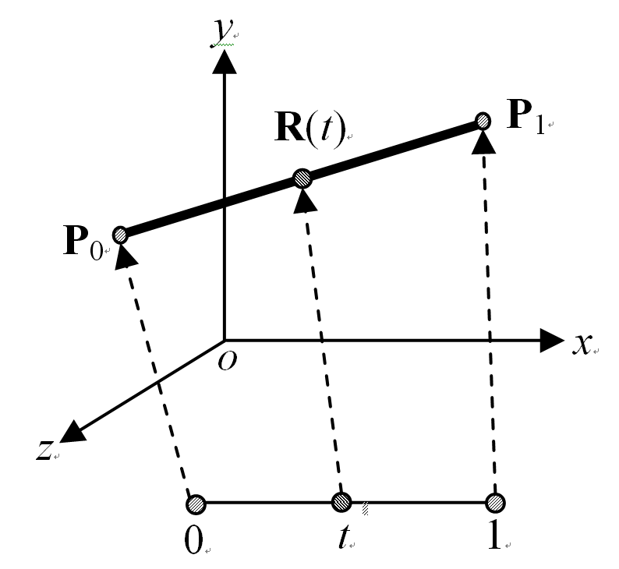
(Cont.) Geometric meaning (几何意义)
Mapping from domain to line segment (映射)
Endpoints correspond.（端点对应）

Slide 6
(Cont.) General parametric curves
General form (一般形式)
Mapping: t ⬅➔ R(t)(参数域⬅➔曲线上点)
In CG, the domain is a finite interval (参数域有限区间➔parametric curve segment (参数曲线段)
In CG: (piecewise分段) (rational有理) polynomials(即x(t),y(t),z(t)是(分段)(有理)多项式)

Slide 7
Bilinear quadrilateral patches (双线性四边形曲面片)
Parametric expression(表达式)
(u,v)∈[0,1]×[0,1]
Four points P₀、P₁、P₂ and P₃
four corners of the surface:
R(0,0)、R(1,0)、R(1,0) and R(0,1)
p3
p0
p2
p1

Slide 8
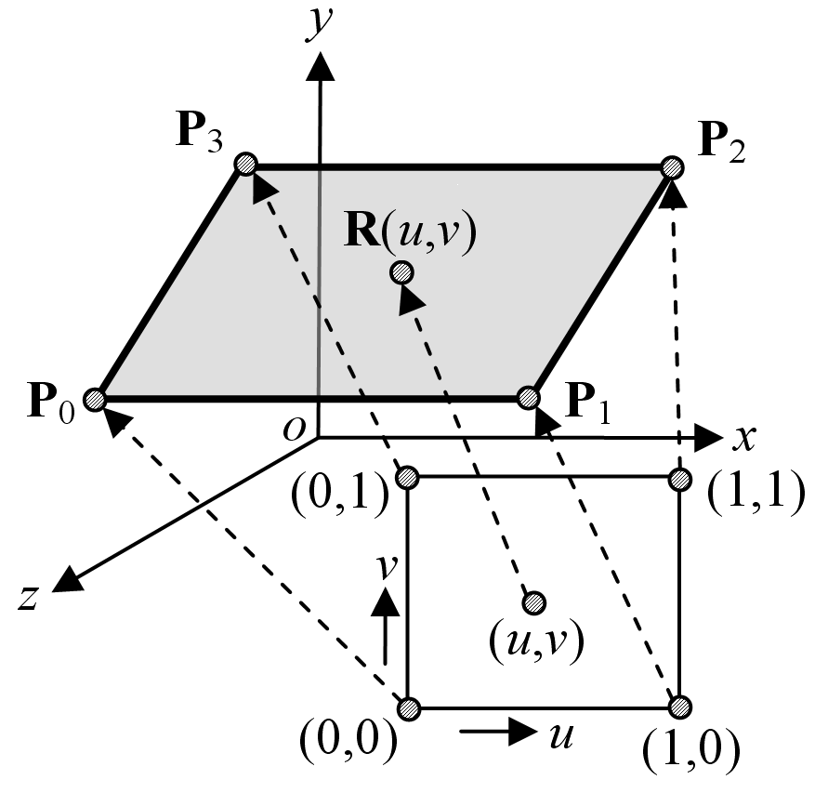
Geometric meaning(几何意义)
Bilinear quadrilateral patch(双线性四边形曲面片)

Slide 9
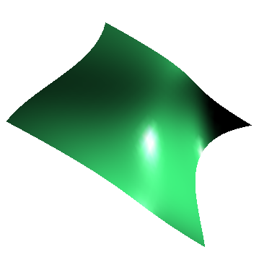
What are parametric surfaces：general surfaces (参数曲面一般形式)
General form (参数曲面的
One-to-one mapping: (u, v)←→R(u,v) (一一映射)
A finite parametric domain, e.g. a rectangle, defines a surface patch (有限的参数域)
Functions are generally (rational) polynomials in CG (图形学中一般用多项式函数)
一般形式)

Slide 10
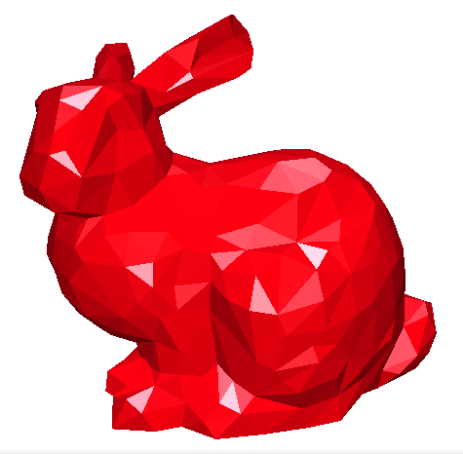

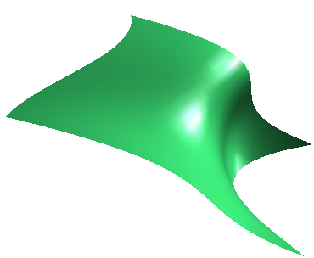
Advantages of Parametric Representation (参数表示的优点)
Explicit representation (参数表示是显式的)
Easy to compute position for given point in parametric domain (易于计算曲面上点的几何属性)
Easy to convert to polygonal meshes (易于网格化)

Slide 11
Advantages of Parametric Representation
Easy to compute geometric attributes: (微分几何：法向、曲率、测地线、曲率线等)
Pseudo-color visualization of mean curvature
(平均曲率伪彩绘制)

Slide 12
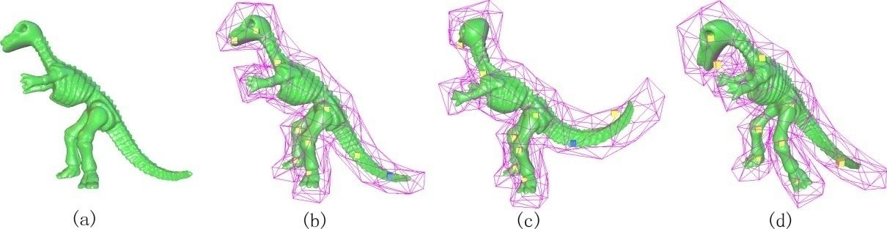
Advantages of Parametric Representation
Easy to control the shape of the surfaces ?
Bézier、B-样条、NURBS (Non-Uniform Rational B-Spline, 非均匀有理B-样条)曲线/曲面
Mesh shape editing needs to solve large scale optimization

Slide 13
Agenda
Parametric surfaces
What are parametric representations
Parametric curves
Bézier curves(曲线)
B-spline (B样条曲线)
NURBS(非均匀有理B样条曲线）
Parametric surfaces

Slide 14
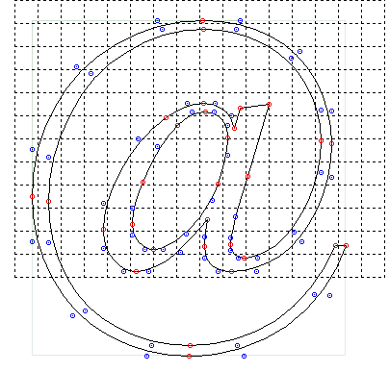
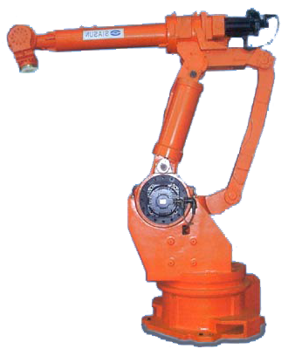
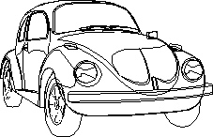

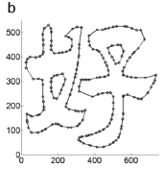
Applications
Shape design
Fonts
Path planning

Slide 15
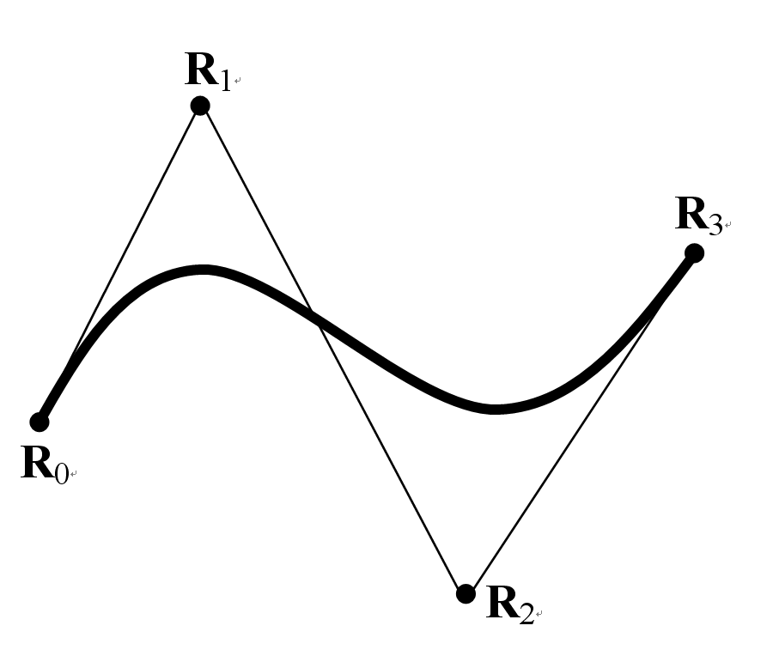
Bézier曲线
给定四个点
Bézier曲线

Slide 16

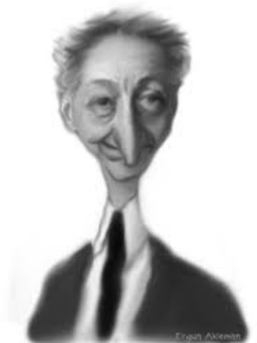
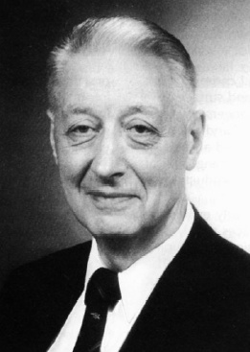
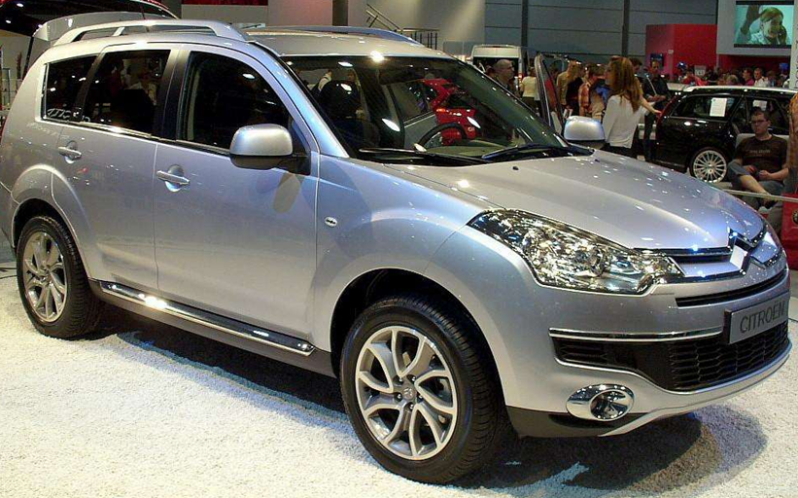
Bézier曲线
Pierre Bézier (1910-1999) in Renault

Slide 17
Definition of Bézier curves(曲线定义)
A Bézier curve of degree n is defined as
Base functions(基函数): {B_{i,n}(t)} (或blending function)：
:Bézier 系数, 是3D点. R(t): 3D向量函数
: control polygon(控制多边形).

Slide 18
Bézier曲线性质
Endpoint interpolation端点插值：
R(0)=R₀ R(1)=R_{n}
三次Bézier曲线
Tangent at endpoints(切向)
R′(0)=n(R₁−R₀)
R′(1)=n(R_{n}−R_{n-1})
Symmetry (对称性)
∑_{i}R_{n-i}B_{i,n}(t) = ∑_{i}R_{i}B_{i,n}(t)
(曲线关于控制多边形是对称的）

Slide 19
Bézier Matrix (Bezier曲线的矩阵表示)
Cubic Bezier curves are most popular
t^{T}
M_{B}
P
Matrix form of general Bezier curves is
Q(t) = t^{T}M_{B}P (M_{B} is the Bézier matrix)

Slide 20
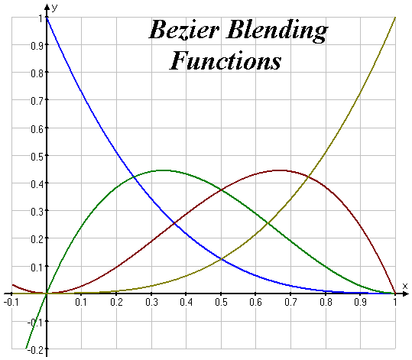
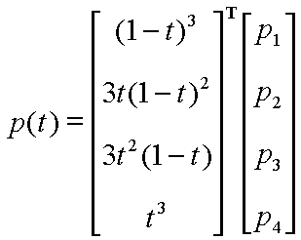
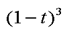
Blending functions(混合(或基)函数)
表达式 基函数的几何形状

Slide 21
Properties of Bézier curves (性质)
Convexity (凸包性)：Bézier curve is enveloped by the convex hull of its control polygon
Geometric invariant (几何不变性), or affine invariant (仿射不变性)
Bézier曲线的凸包性
P₁
P₂
P₁
P₂
P₃
P₃
P₀
P₀

Slide 22
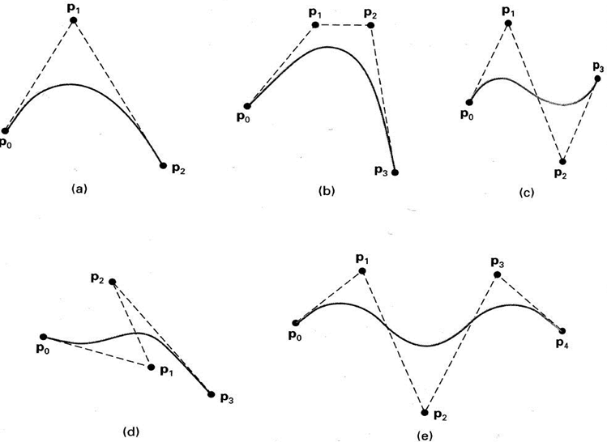
Some examples (例子)

Slide 23
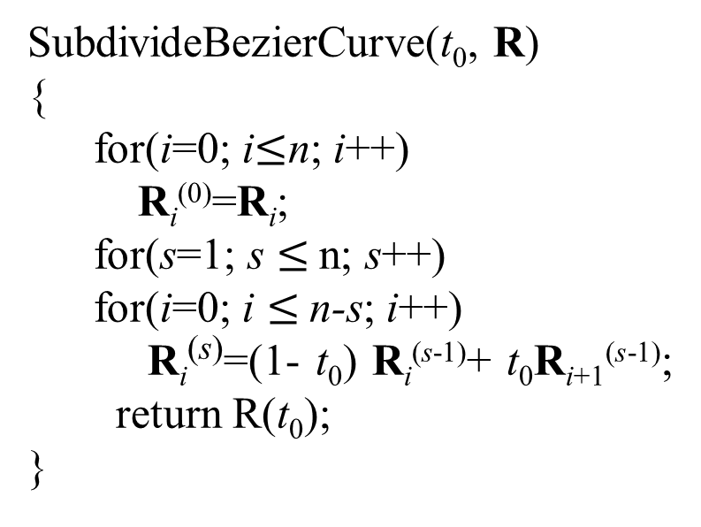
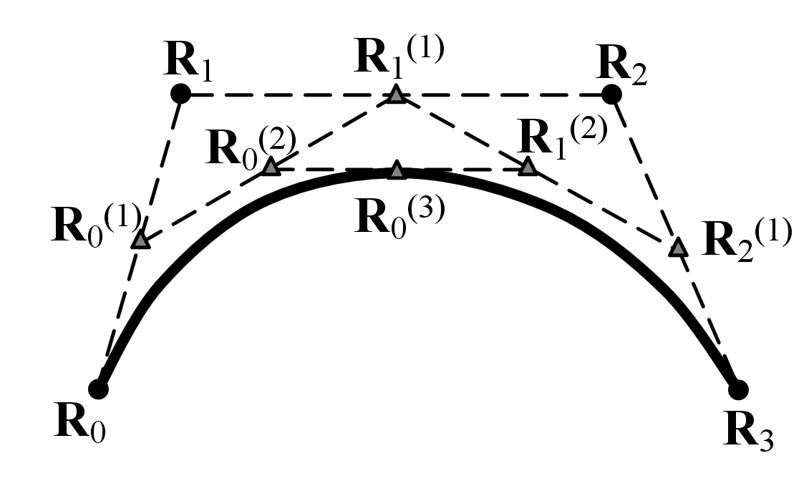
Bézier曲线细分性质
SubdivideBezierCurve(t₀, R)
{
for(i=0; i$≤$n; i++)
R_{i}⁽⁰⁾=R_{i};
for(s=1; s $≤$n; s++)
for(i=0; i $≤$n-s; i++)
R_{i}^{(s)}=(1- t₀) R_{i}^{(s-1)}+ t₀R_{i+1}^{(s-1)};
return R(t₀);
}
Illustration of Cubic Bézier curve subdivision
subdivision algorithm of Bézier curve of degree n
(Bézier曲线细分算法)
Reference：http://en.wikipedia.org/wiki/B%C3%A9zier_curve

Slide 24
Bézier曲线的细分性质
The curve is split into two(一段分为两段):
The control polygon approximates the curve with the increasing of subdivision depth
(控制多边形越来越逼近曲线本身)
It can be used to render the curve(绘制多边形)

Slide 25
Disadvantage of Bézier curves
Global property(全局性)：the whole
shape will change when a
control point moves
For complex shapes, we need to stitch multiple Bezier curves (复杂形状需拼接)
Position continuity(位置连续)：C⁰(或G⁰)
Smoothness: n次导数C^{n}(或几何G^{n})连续

Slide 26
Agenda
Parametric curves and surfaces
参数表示的数学原理
Parametric curves(参数曲线)
Bézier曲线
B-spline (B样条曲线)
NURBS曲线
参数曲面

Slide 27
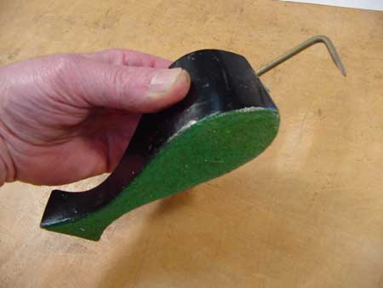
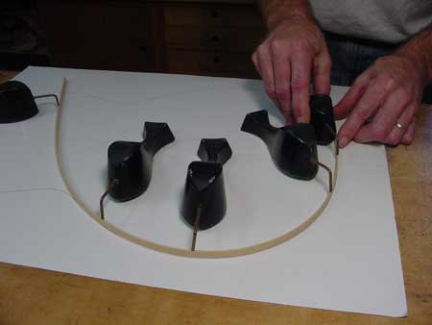
历史
A Duck (weight)
Ducks trace out curve

Slide 28
B-spline: example(样条曲线实列)
R₂
R₁
R₇
R₃
R₀
R₄
R₆
R₅
B-spline of degree 3(order 4) (三次(四阶)B样条曲线)

Slide 29
Definition of B-splines(B样条曲线定义)
B-spline curve is piecewise polynomial curve (分段多项式曲线)
Given knot vector(节点向量)
u={u₀, u₁, …, u_{i}, …, u_{n+k+1} }
A B-spline of degree k (order k+1) with (n+1) control points is defined as
K次或k+1阶B样条
分段多项式

Slide 30
Definition of basis of B-splines
R_{i:} control points，{R_{i}}_{i=0,1,…,n}: control polygon
N_{i,k}(u) are basis of B-spline：

Slide 31
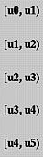
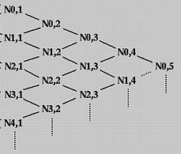
递归关系

Slide 32
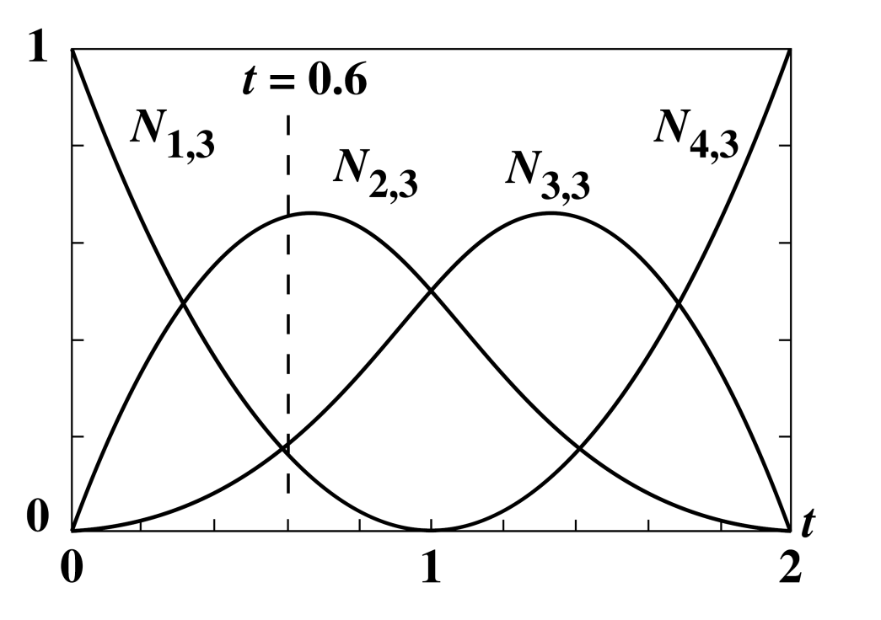
Bases satisfy normalization
n=3 (4个控制顶点)
k=3 三次(四阶)曲线
u=[0 0 0 1 2 2 2 2]
在 u = 0.6 处，
基函数的和为：
N_{0,3}+N_{1,3}+N_{2,3}+N_{3,3} =0.16+0.66+0.18+0.0= 1.0
u
N_{0,3}
N_{2,3}
N_{3,3}
N_{1,3}

Slide 33
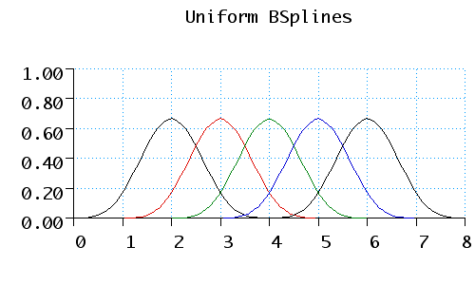
Periodic uniform knot (周期均匀B样条)
Periodic knots are determined from
U_{i} = i (0 ≤ i ≤ n+k)
Example
Curve with degree 3 and 4 control points (cubic B-spline)
(k = 3, n = 3) → number of knots = 8
(0, 1, 2, 3, 4, 5, 6, 7)
The basis splines over the full domain of u

Slide 34
Periodic uniform knot
Normalize u (0≤ u ≤ 1,规范化参数域)
N_{0,3}(u) = 1/6 (1-u)³
N_{1,3}(u) = 1/6 (3u ³ – 6u ² +4)
N_{2,3}(u) = 1/6 (-3u ³ + 3u ² + 3u +1)
N_{3,3}(u) = 1/6 u³
参数曲线
R(u) = N_{0,4}(u)R₀ + N_{1,4}(u)R₁ + N_{2,4}(u)R₂ + N_{3,4}(u)R₃

Slide 35
Periodic uniform cubic spline: Matrix
In matrix form (矩阵表示)

Slide 36
Periodic uniform knot
P₀

Slide 37
Closed periodic
Example
k = 4, n = 5
P₂
P₁
P₃
P₀
P₄
P₅

Slide 38
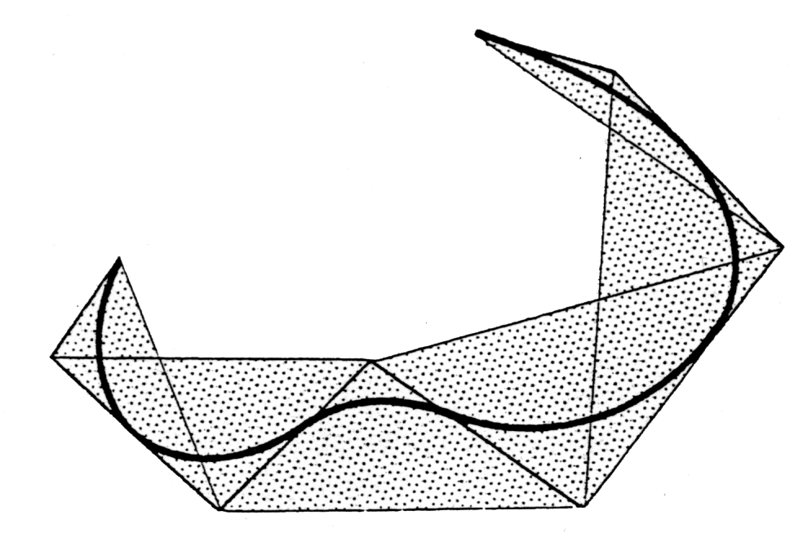
Properties of B-splines (性质)
B-spline satisfies convex hull property and geometric invariant property
More strict than Bezier curves
closure
Quadratic B-spline (二次B样条)

Slide 39
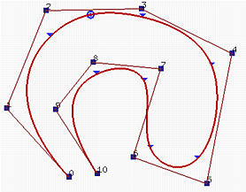
Open B-splines(非周期均匀B样条)
节点向量在端点处重复k+1次
B样条曲线会插值端点
端点处切向量与边一致
For n=k+1，the B-spline degenerates to a Bézier curve

Slide 40
(Continued)
Local property：(当移动一个控制顶点时，只影响曲线的局部区域)
Local property of B-spline of degree 3

Slide 41
Agenda (omitted)
参数曲面表示
参数表示的数学原理
参数曲线
Bézier曲线
B-样条曲线
NURBS曲线
参数曲面

Slide 42
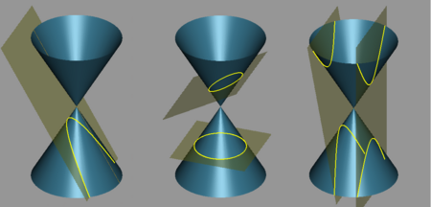
引入NURBS曲线的原因
B-样条情形不能精确表示二次曲面与平面的交线，如圆锥曲线(平面与圆锥的交线)
抛物线
椭圆(上)与圆(下)
双曲线

Slide 43
NURBS曲线
NURBS (Non-Uniform Rational B-Spline)：非均匀有理B-样条的简称
定义：

Slide 44
NURBS曲线
{N_{i,k}(u)}为单位化的B-样条基函数
{R_{i}}为控制顶点
NURBS曲线新增加的曲线控制手段是权因子{ω_{i} }，
首末两个权因子ω₀>0、ω_{n}>0
其余的权因子满足ω_{i}≥0

Slide 45
NURBS曲线的权因子
每一个权因子对应于一个控制顶点
调整权因子的大小可以调整曲线的形状。
当所有的权因子ω_{i}=1时，就是B-样条曲线；
当某个权因子ω_{i}=0时，对应的控制顶点对曲线的形状没有影响
当ω_{i}→∞时，曲线R(u) →R_{i} ，即曲线过点R_{i}

Slide 46
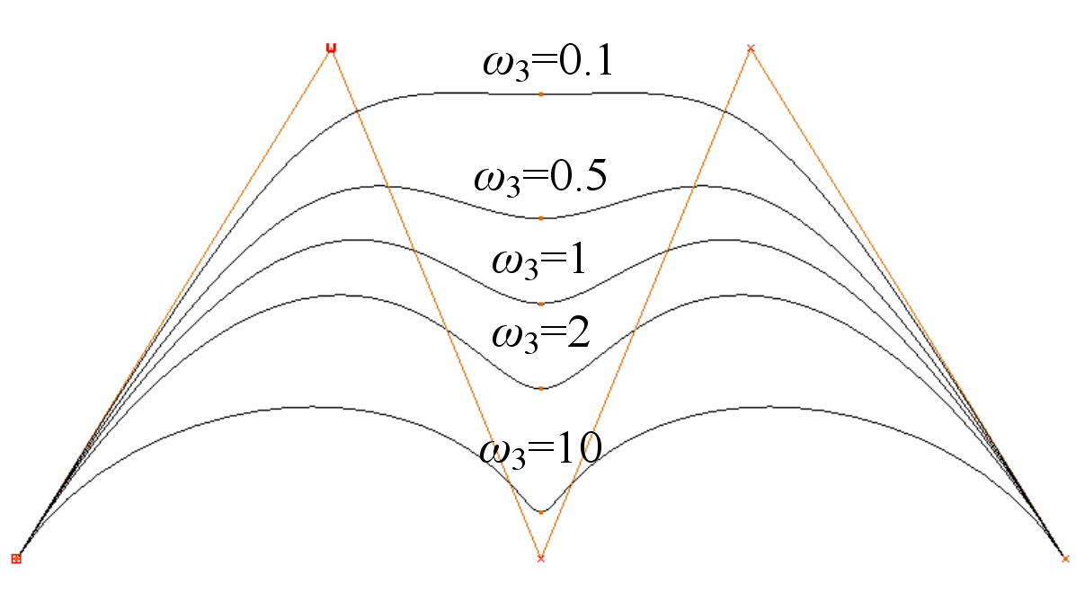
NURBS曲线的例子
NURBS曲线权因子对曲线形状的影响

Slide 47
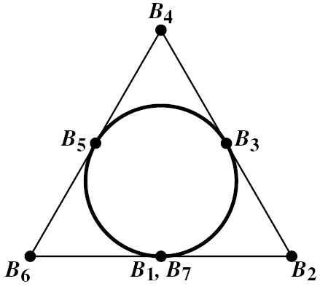
NURBS曲线表示圆
R₃
用三个120°圆弧表示圆：
u=[0 0 0 1 1 2 2 3 3 3]
k = 3
[ω_{i}] = [1, ½, 1 , ½, 1, ½, 1]
控制顶点分布如右图所示
R₄
R₂
R₅
R₆
R₀
R₁
NURBS曲线表示圆

Slide 48
Agenda
Parametric curves and surfaces
参数表示的数学原理
参数曲线
Parametric surfaces
Bézier surfaces
B-样条曲面
NURBS曲面

Slide 49
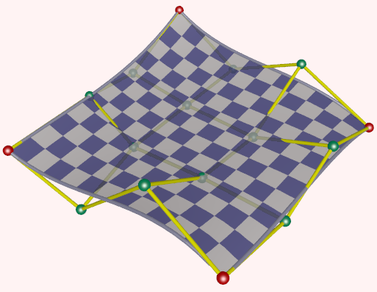
Bicubic Bézier surfaces(双三次)
双三次Bézier曲面实例

Slide 50
Bézier曲面
m×n次Bézier曲面：
B_{i,m}(u) & B_{j,n}(v) are Bernstein bases (基函数)
{R_{ij}} form a grid mesh规则连接形成控制网
v
n row
m col.
u

Slide 51
Properties of Bézier surfaces
The control mesh constrains the coarse shape of Bézier surfaces

Slide 52
Continued
Interpolation (插值) of four corner vertices:

Slide 53
Continued
Tangents at four corner vertices
Subdivision of Bézier surfaces：用加密的控制网格来逼近Bézier曲面

Slide 54
Rendering of Bézier surfaces(曲面绘制)
Vector3D P[][]={{},…,{}}; // Control mesh
MyBezSurfDisplay()
{ …;float step = 0.01;
glBegin(GL_QUADS);
for (u = 0; u <1; u+=step)
for (v = 0; v<1; v+= step){
ver0 = Bezier(u,v); ver1 = Bezier(u+step, v);
ver2 = Bezier(u+step,v+step); ver1 = Bezier(u,v+step);
计算上述4个点的法向n0,n1,n2,n3;
glNormal3fv(n0); glVertex3fv(v0); glNormal3fv(n1); glVertex3fv(v1);
glNormal3fv(n2); glVertex3fv(v2); glNormal3fv(n3); glVertex3fv(v3);
}
glEnd(); …;
}

Slide 55
Drawbacks of Bézier surfaces
Global property：It is not convenient for editing based control vertex change(全局性)
It is difficult to smoothly merge multiple Bezier patches (光滑地拼接：困难)

Slide 56
内容
参数曲面表示
参数表示的数学原理
参数曲线
参数曲面
Bézier曲面
B-样条曲面
NURBS曲面

Slide 57
B-spline surfaces (B样条曲面)
Definition of B-spline surfaces
Degree：k_{u} + k_{v}
Number of control points(控制顶点数)：
(n_{u}+1) × (n_{v}+1)
Knot vectors(节点向量)

Slide 58
B-spline surfaces (B样条曲面)
The surface (定义成张量积)
{R_{ij}}: control point set
N_{i,ku}(u) and N_{i,kv}(v) B-spline basis defined in knot vectors respectively

Slide 59
Properties of B-spline surfaces
Local property(局部控制)
The number of control points (控制顶点数)
Can be arbitrary for B-spline surfaces of fixed degree(次数确定，控制顶点数可任意)
(Bézier曲面的次数确定后，控制顶点数目就定了)
Other properties: see properties of B-spline curves(其性质与曲线类似)

Slide 60
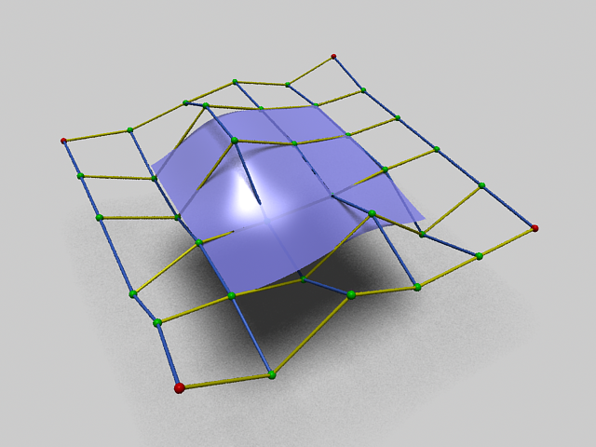
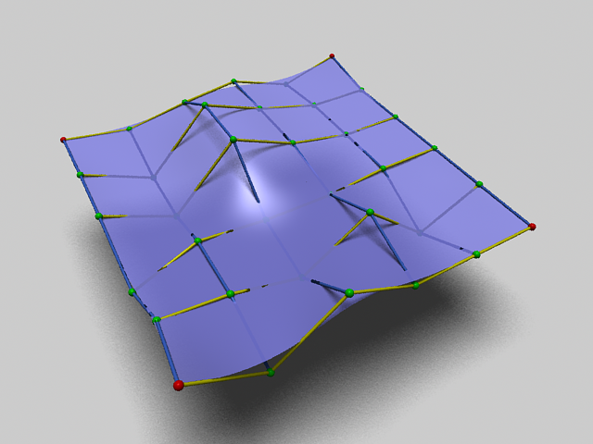
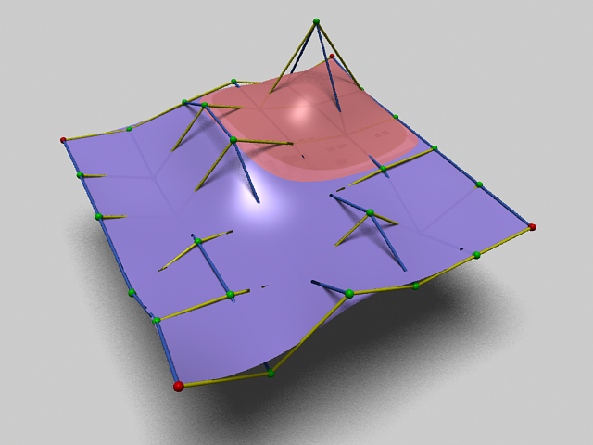
B-spline surfaces: examples
R_{4,4}
R_{5,5}
R_{5,5}
R_{5,5}
R_{0,5}
R_{0,5}
R_{0,5}
R_{5,0}
R_{5,0}
R_{5,0}
R_{0,0}
R_{0,0}
R_{0,0}
(a) Uniform knots
(b) 端点重节点
(c)Local property of B-spline surface
具有6×6个控制顶点双三次B-样条曲面：
(a) 均匀节点向量u= v =[-4, -3, -2, -1, 0, 1, 2, 3, 4, 5]，所构造曲面不插值角点
(b) 具有端点处4阶重节点的节点向量u= v =[0, 0, 0, 0, 1, 2, 3, 3, 3, 3]，曲面插值角点
(c) 采用了与图(b)相同的节点向量，扰动顶点R_{4,4}的位置后，其形状变化的红色区域局限于变动顶点的邻域中．

Slide 61
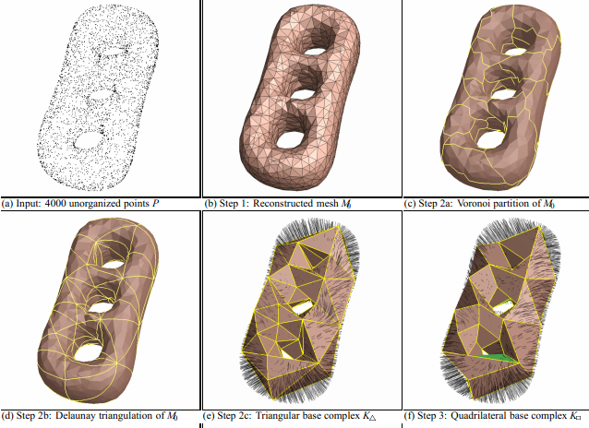
Reconstruction(重构，Eck & Hoppe)

Slide 62
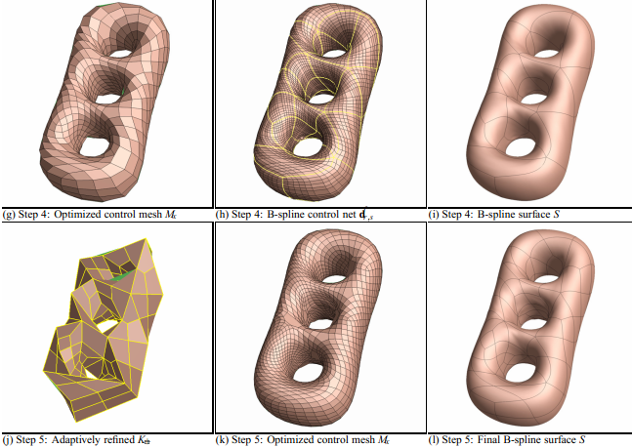

Slide 63
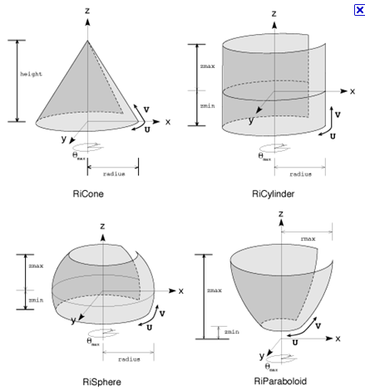
Drawbacks of B-spline surfaces
It can not exactly represent conic surfaces
(不能精确表示二次曲面：球面、圆柱面、圆锥面等)

Slide 64
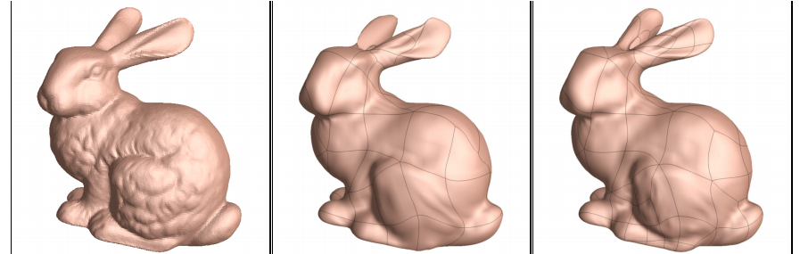
Drawbacks of B-spline surfaces
Smooth stitching is also difficult(光滑拼接r仍然困难)

Slide 65
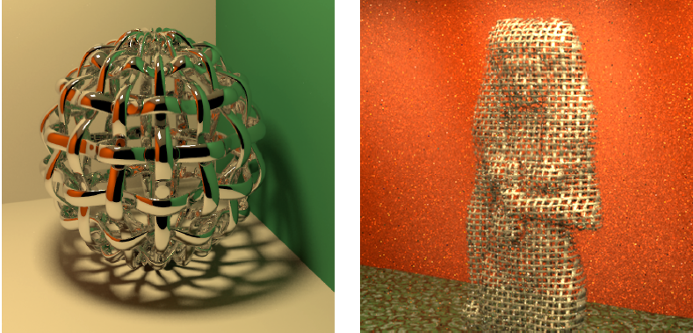
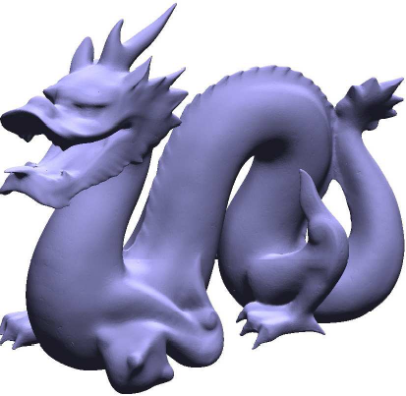

It is more difficult for complicated objects

Slide 66
内容
参数曲面表示
参数表示的数学原理
参数曲线
参数曲面
Bézier曲面
B-样条曲面
NURBS曲面

Slide 67
NURBS曲面(omitted)
NURBS曲面
增加了权因子作为形状控制手段
包含B-样条曲面和Bézier曲面
可以精确表示机械零件中常用的二次曲面
工业产品几何定义的STEP标准 (1991年):
自由曲线曲面唯一地采用NURBS表示

Slide 68
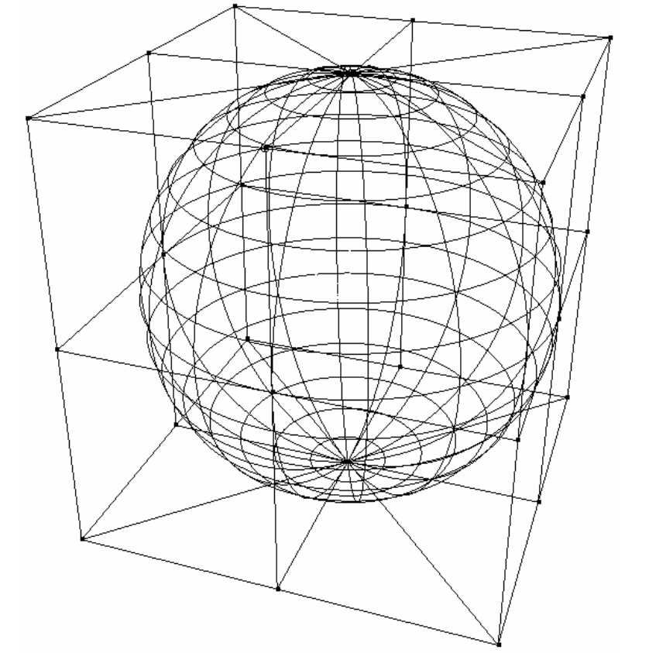
NURBS曲面表示球面
NURBS精确表示的球面及其控制顶点

Slide 69
小结
物体的参数曲面表示
参数表示的数学原理：曲线、曲面
参数曲线：Bézier、B-样条和NURBS曲线
参数曲面：Bézier、B-样条和NURBS曲面
参数曲线与曲面的绘制

